Slide 1


PANIMALAR ENGINEERING COLLEGE
Department of Computer Science and Engineering
VOCAL AND GESTURE BASED COMMUNICATION FOR/BY DISABLED PERSONS.
Domain:
(IOT , NLP, DEEP LEARNING)
Guide :
A. Karthekeyan
Team Members:
M.SRINIVASAN (211417104269)
M.MILIND KUMAR (211417104326)
S.RIYAZ UDEEN (211417104501)

Slide 2
Introduction
There is a huge communication gap between a normal and a differently-abled person, our project mainly aims to bridge the communication gap between them.
It is really difficult for us to understand what they are trying to say exactly and vice versa in case of deaf and dumb.
To avoid this complexity in understanding each other we develop a Vocal and Gesture based Companion for disabled persons.
This product is used for two way communication.

Slide 3
In case of a Normal person-> Differently abled:
The person speaks the content like(ONE, TWO, ALL THE BEST, etc..) and this will get converted into sign language using NLP and is fed as a sign language on the display screen.
So as a result, this device acts as an interface between the two parties.
The output will be in vocal and pictorial representation.
For Differently abled ->Normal person
We use Deep Learning to analyse sign language shown by the disabled person and the analysed result is converted into text format and produced as vocal output.
So as a result, this device acts as an interface between the two parties.
The output will be in vocal and pictorial representation.

Slide 4
OBJECTIVE OF THE PROJECT
The main objective of this project is to bridge the communication gap between the differently-abled and the normal person and make the process comfortable.
It is really difficult for us to understand what they are trying to say exactly and vice versa in case of deaf and dumb.
To avoid this complexity in understanding each other we develop a Vocal and Gesture based Companion for disabled persons.
This device interprets the sign language for us to be understood and interprets our speech into sign language which can be viewed by differently-abled.

Slide 5
EXISTING SYSTEM
There are very few Existing systems/devices for disabled persons (deaf and dumb) and one among them is the Smart glove to Capture Gesture.
Even Though it’s existing it’s not affordable for real time utilization because of the following drawbacks.
1. Both the user should have a device
2. Bulky to wear and difficult to handle
3. Consist of dedicated components which are quite
expensive.

Slide 6
PROPOSED SYSTEM
We build a single wearable device for disabled people with an embedded camera, mike and speaker.
A normal person just needs to speak, so the vocal input is captured and converted to a sign language which is visible for an disabled person to understand.
With the help of an Embedded camera and speaker, the gestural reply is captured, analyzed and converted to vocal format.
Advantage:
1. One device is sufficient
2. Lightweight and compact using 3D Modeling
3. Easy to handle

Slide 7
Software / Hardware
Software :
Python
Embedded C/C++
Fusion360 (3D modelling)
Hardware :
Raspberry pi 4 , RPI Camera
Audio devices (Speaker, Mike)
3D Printer
Supporting IoT Components

Slide 8
SYSTEM DESIGN:

Slide 9
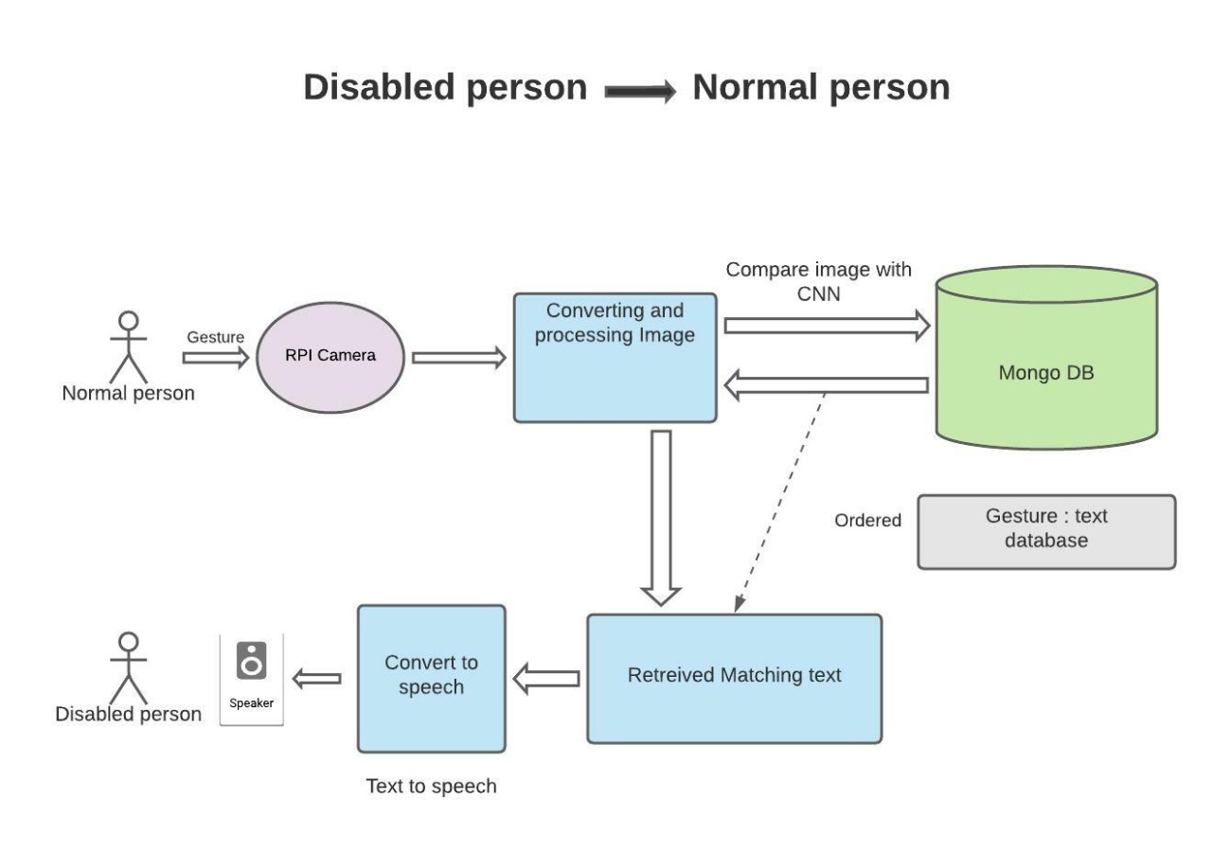
Architecture / Methodology used
Fig 1: Disabled to Normal Architecture

Slide 10
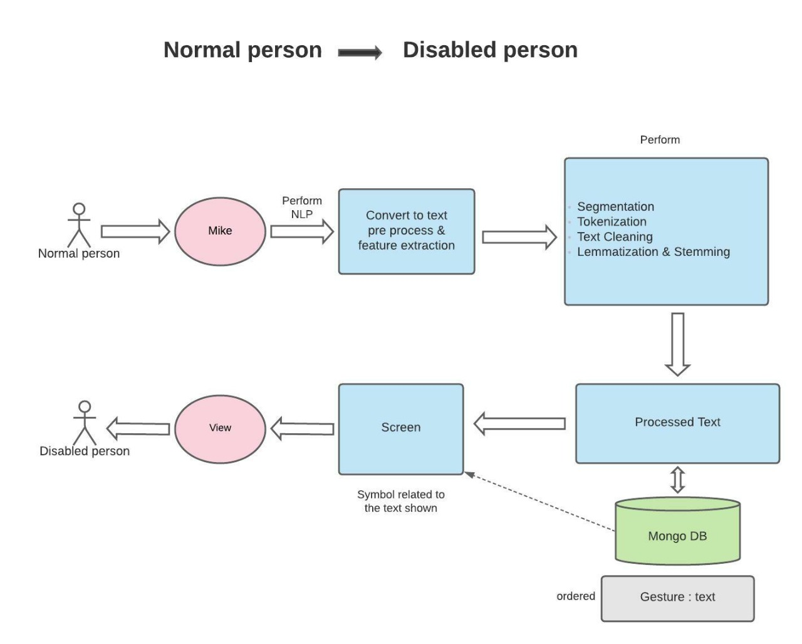
Fig 2: Normal to Disabled Architecture

Slide 11
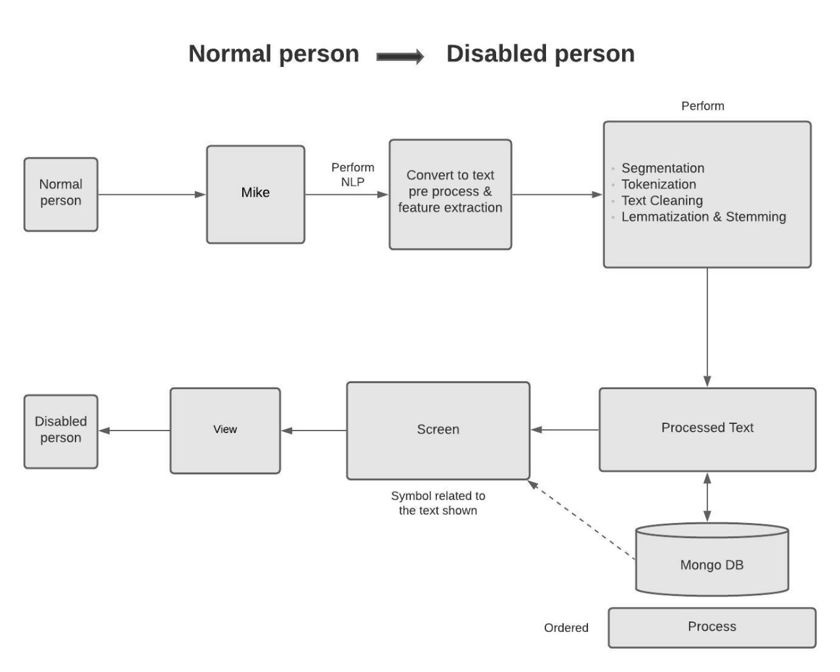
Data-flow diagram
Fig 3: Data Flow Diagram 1

Slide 12
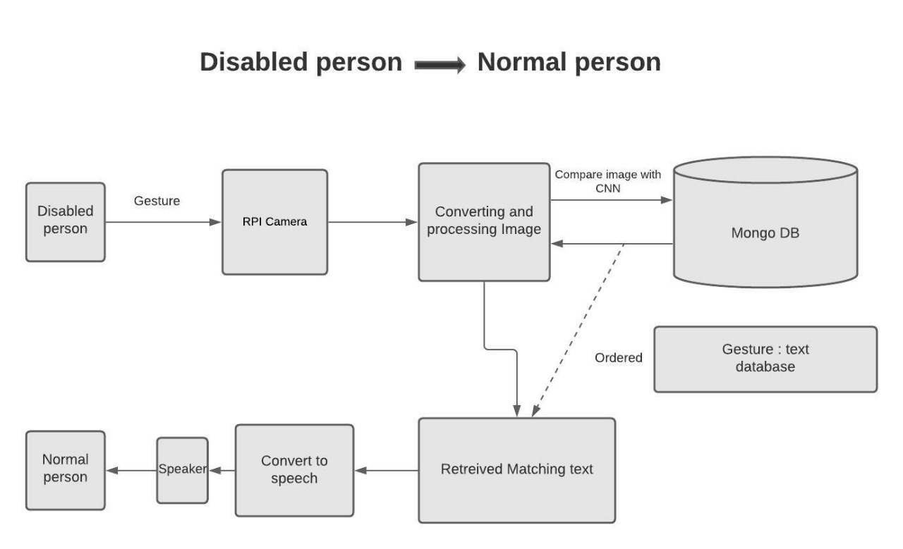
Fig 4: Data Flow Diagram 2

Slide 13
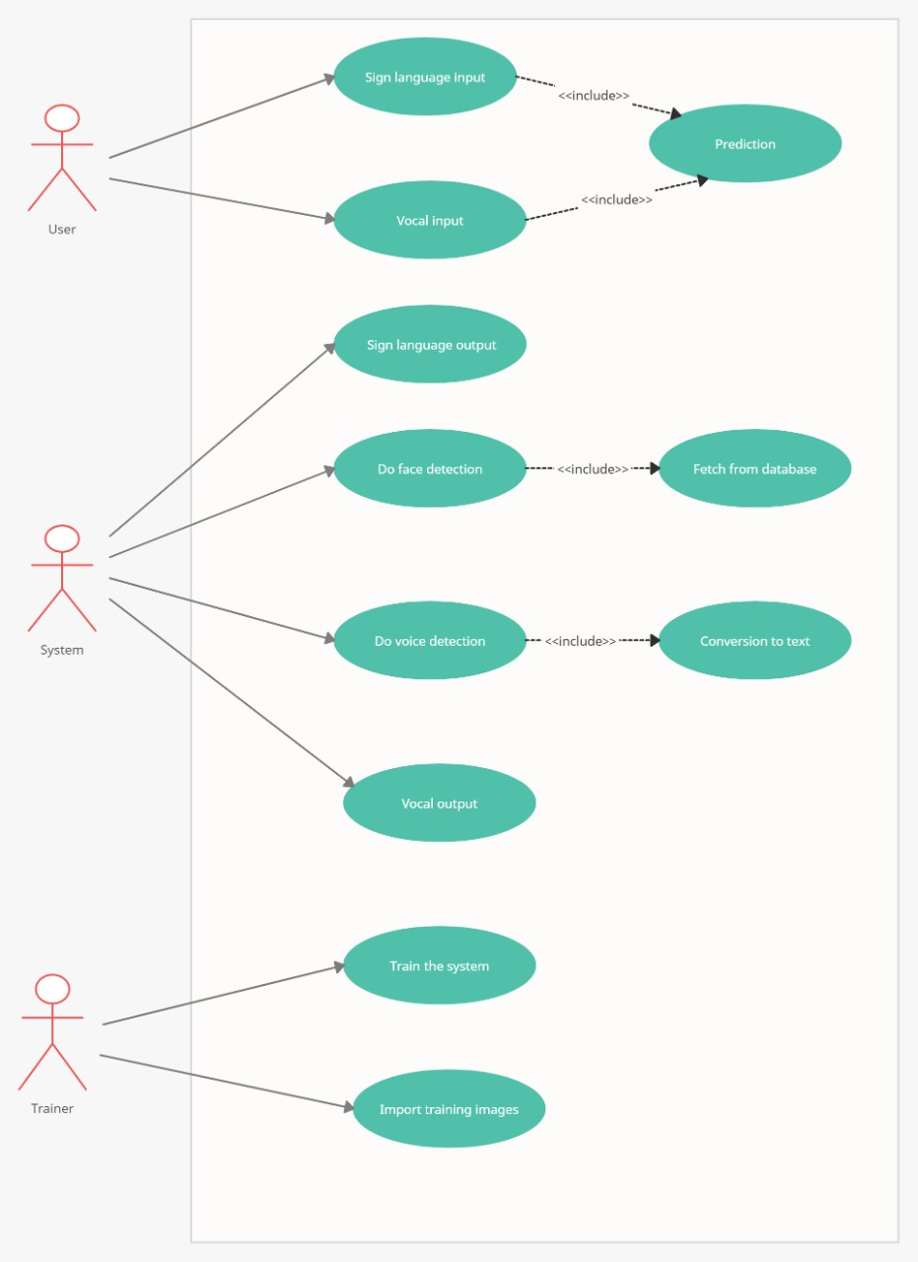
Use-Case diagram
Fig 6: Use Case Diagram

Slide 14
ALGORITHM AND MODEL DESCRIPTION:
Disabled to Normal:
Step 1: A disabled person performs gesture through sign language.
Step 2: This sign language is captured by the RPI camera
Step 3: This image is converted from raw content into a processed image.
Step 4: This image is sent into the Mongo database for further development.
Step 5: This image is Compared using CNN (Convolutional Neural Network) with the images in the database.
Step 6: The matched images are retrieved from the database as a text.
Step 7: Then this text is converted into speech using NLP (Natural language processing).T
Step 8: This text is then fed into the speaker
step 9: Thus the communication between the disabled and normal person is achieved.

Slide 15
Normal to Disabled:
Step 1: The normal person speaks through the mike to communicate.
Step 2: This vocal input is converted into text using NLP (Natural Language Processing)
Step 3: Then this raw data goes under various process to turn it into a processed data
Step 4: this process undergoes segmentation, tokenization, text cleaning, lemmatization and stemming.
Step 5: now the raw data is converted into a processed text.
Step 6: this processed text is compared with the text contained in 0the mongo database.
Step 7: The corresponding gesture images of the matched text is retrieved.
Step 8: The retrieved text is displayed through a screen to make it understandable for the disabled person.
Step 9: Thus the communication between the normal and the disabled person is achieved.

Slide 16
Module Description
As the communication in the device is happened, the modules developed for the system includes
1) Training of Sign Language
2) Implementation of Sign Language using IOT
3) Training and Implementation using NLP

Slide 17
Training of Sign Language
In this module, the image captured during the sign language communication is trained using CNN for image dataset.
The voice captured during communication is trained for vocal dataset using NLP and RNN. We use ISTM for immediate recovery of data and to prevent false prediction.

Slide 18
Implementation of Sign Language using IOT
In this module, the RPI camera is used for capturing image with Azure IOT Hub with Azure ML Platform.
The hand gestures of sign language is captured and sent to the cloud for processing. Results after processing are fetched and data is stored in ISTM.

Slide 19
Training and Implementation using NLP
In this module, Natural Language Processing is done over cloud in Azure. Auto correction is done on the vocal input and converted to text using RNN.
String stripping and keyword identification is done in processed text to detect accurate sign language.

Slide 20
TESTING/PERFORMANCE ANALYSIS:
HOST ID | MODULE NAME | INPUT | EXPECTED OUTPUT | ACTUAL OUTPUT | REMARKS
TC01 | Sign Language gesture Module | Detection of the sign languages. | Corresponding meaning to those sign languages in vocal format | Pass | Module works as expected.
TC02 | Vocal input Module | The message to be sent is spoken | The words spoken is converted into a sign language | Pass | Module works as expected.

Slide 21
LITERATURE SURVEY
TITLE | AUTHOR | YEAR | JOURNAL | INFERENCE
PAPER 1: HOG-based Hand Gesture Recognition Using Kinect | Kevin Nathanael Kris Andria, Bima Sena Bayu Dewantara, Dadet Pramadihato. | 2019 | IEE | In this paper, we build interactions between humans and computers using hand gestures. The hand gesture is recognized by the palm of the hand which is obtained from the results of human skeleton segmentation through camera Kinect. Recognition of palm gestures is performed on a series of RGB Kinect output frames. Dynamic Time Warping (DTW) is used as a classifier that will compare the description of the input gesture with the template gesture description. Based on the results of the experiment, the performance of the hand gesture recognition system reached 76.7%.

Slide 22
TITLE | AUTHOR | YEAR | JOURNAL | INFERENCE
Paper 2: “IoT Device for Disabled People” | Shankar, Mallika Chowdhary, Priyadarshini. | 2019 | IOT | In this paper, we build interactions between humans and computers using hand gestures. The hand gesture is recognized by the palm of the hand which is obtained from the results of human skeleton segmentation through camera Kinect. Recognition of palm gestures is performed on a series of RGB Kinect output frames.

Slide 23
TITLE | AUTHOR | YEAR | JOURNAL | INFERENCE
Paper 3: “Smart hand gloves for disable people for communication” | Dhaval L. Patel, Hershel S. Tapase, Praful A. Landge, | 2018 | IOT | Smart Hand Gloves help disable people to live with normal people. As dumb person cannot speak then this smart glove helps him to convert his hand gesture into text and pre-recorded voice. This also help normal person to understand what he is trying to say and reply accordingly. This Smart Gloves has facility of Home Appliance control from which a physically impaired person become independent to live. The main objective of the implemented project is to develop a reliable, easy to use, light weight smart hand gloves system which can minimizes the obstacles for disable people where they can stand with the race.

Slide 24
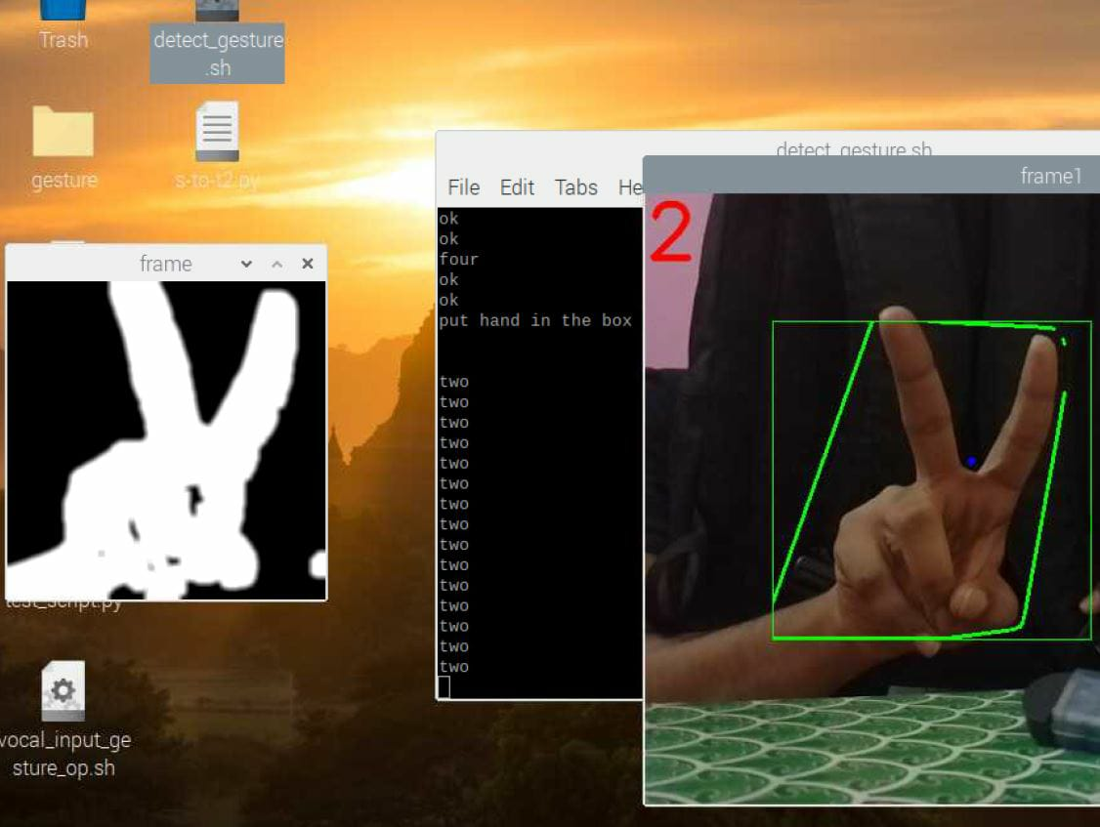
Screenshots.
Fig 7: Gesture Recognition

Slide 25
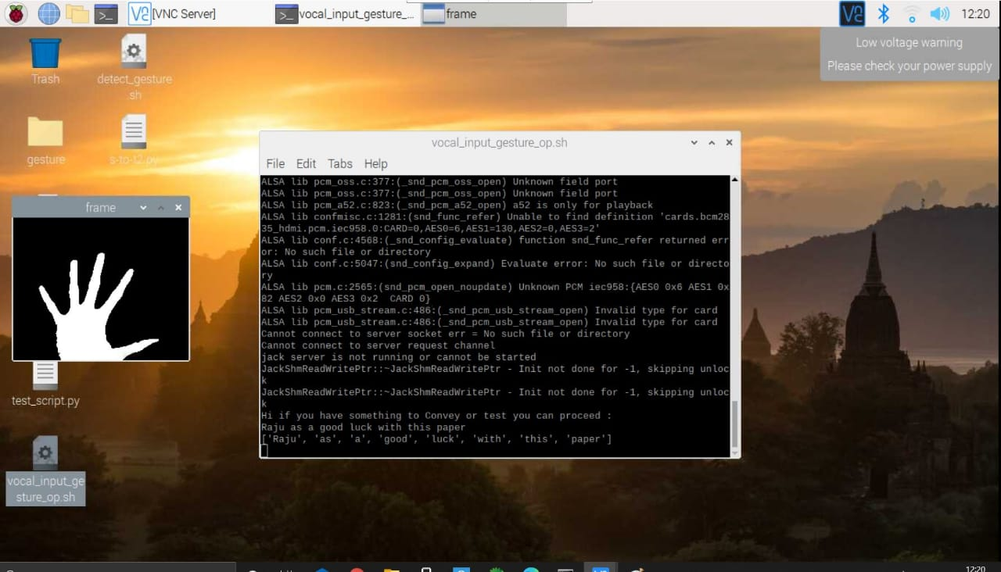
Fig 8: Voice to Gesture

Slide 26
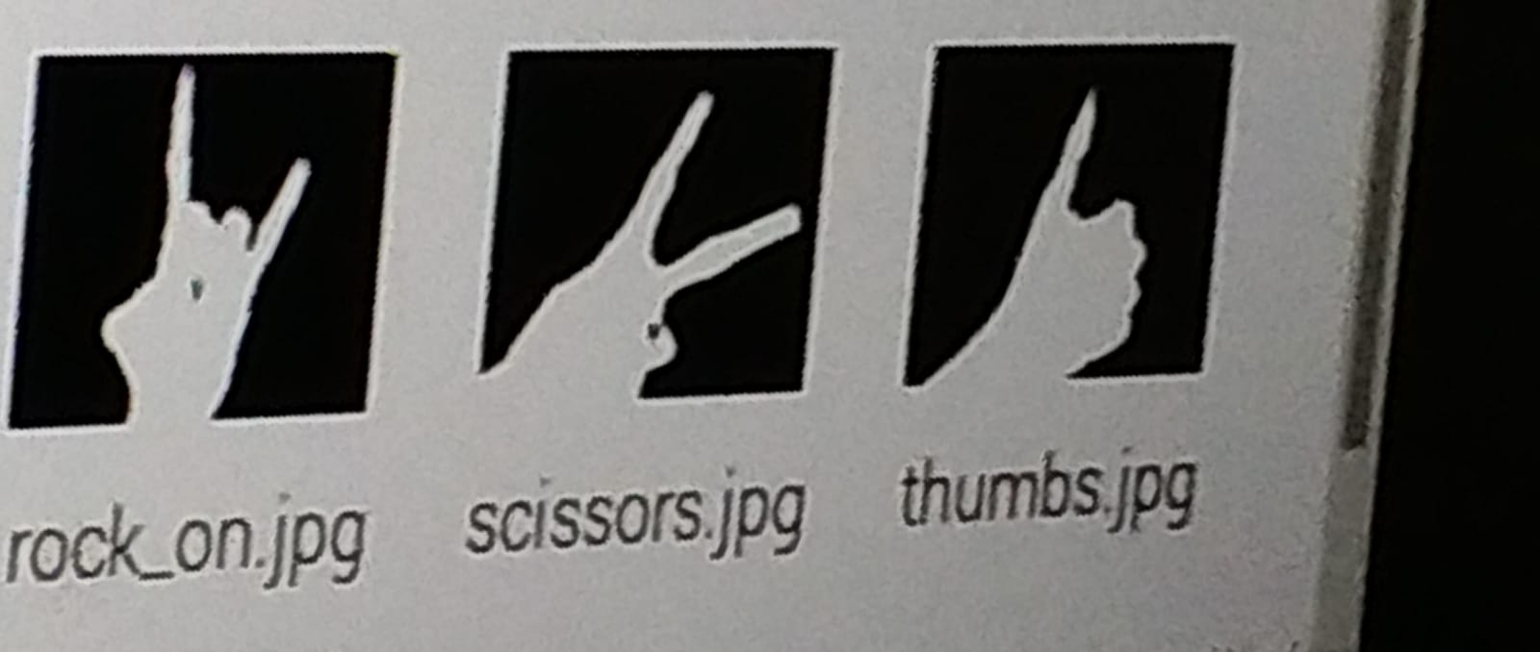
Fig 9: Preloaded Images

Slide 27
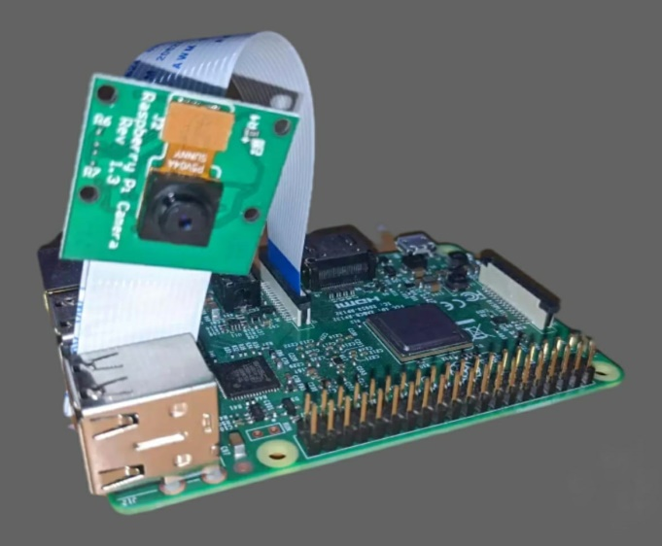
Fig 10: Working Model

Slide 28
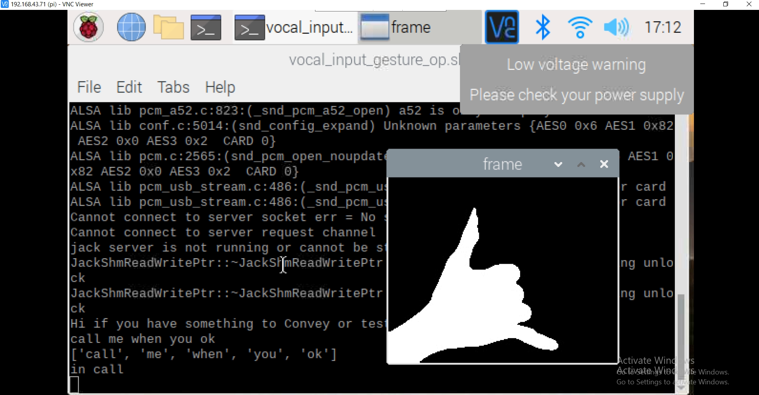
Fig 11: Vocal to Gesture

Slide 29
CONCLUSION
The main objective of this project is to solve the difficulty for us to understand what they are trying to say exactly and vice versa in case of deaf and dumb.
This process is made hassle-free as a normal person doesn’t have to know sign language to communicate.
Thus the main problem of bridging the communication gap between the normal and differently-abled is solved.

Slide 30
FUTURE SCOPE
The future scope is to overcome the conventional technology and to develop a much easier and better technology for the communication process.

Slide 31
References
K. V. Fale, Akshay Phalke, Pratik Chaudhari, Pradeep Jadhav. “Smart Glove: Gesture Vocalizer for Deaf and Dumb People”. International Journal of Innovative Research in Computer and Communication Engineering, Vol. 4, Issue 4, April 2016.
Ms. Pallavi Verma, Mrs. Shimi S. L., D r. S. Chatterji. ”Design of Smart Gloves”. International Journal of Engineering Research & Technology (IJERT), ISSN: 2278-0181.Vol. 3 Issue 11, November-2014.
Harmeet Kaur, Amit Saxena, Abhishek Tandon, Keshav Mehrotra, Khushboo Kashyap. “A Review Paper On Evolution Of Smart Glove”. International Journal of Scientific Research and Management Studies (IJSRMS), ISSN: 2349-3771, Volume 3 Issue 3, pg: 124-128.
Rafiqul Zaman Khan and Noor Adnan Ibraheem, “Hand Gesture Recognition: A Literature Review”, International Journal of Artificial Intelligence & Applications (IJAIA), Vol.3, No.4, July 2012.
Priya Matnani, “Glove Based And Accelerometer Based Gesture Control: A Literature Review”, International Journal of Technical Research and Applications e-ISSN: 2320-8163, www.ijtra.com Volume 3, Issue 6 (November-December, 2015), PP. 216-221.
Laura Dipietro, Angelo M. Sabatin, ―A Survey of Glove-Based Systems and Their Applications‖, IEEE Transactions on systems, man, and cybernetics-part c: applications and reviews, Vol-38, No-4, pp-461-482, July 2008.
Rajam, P. Subha and Dr. G Balakrishnan, "Real Time Indian Sign Language Recognition System to aid Deaf and Dumb people", 13th International Conference on Communication Technology (ICCT), pp. 737- 742, 2011.

